Slide 1


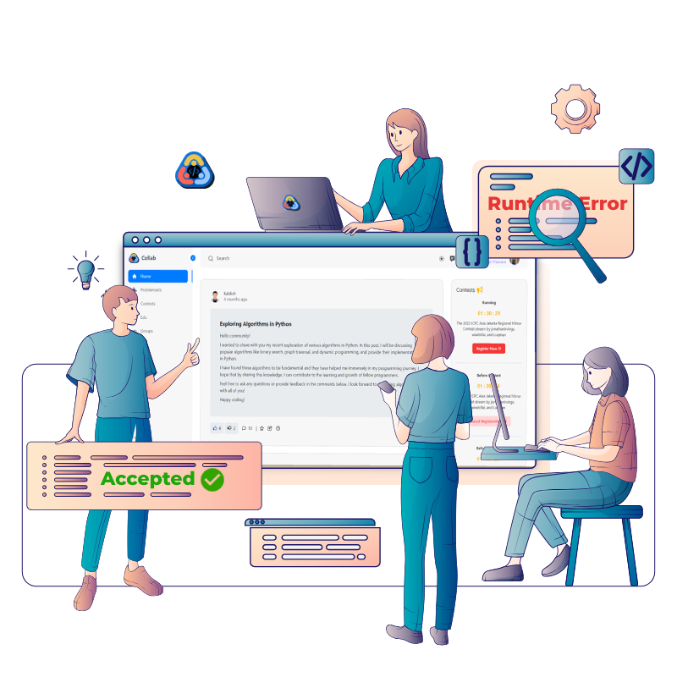

CollabCode
Collaborative Competitive Programming Platform
An online judge web application aimed at those interested in competitive programming, especially those interested in programming competitions, for training in a collaborative environment.

Slide 2

Our team
Ibrahim Kaldesh
Khaled Ramadan
Ahmed Abosalem
Mahmoud Essam
Ahmed Hamdy
Mahmoud Hawara
Supervised by
Assoc. Prof. Lamiaa Elrefaei

Slide 3
Agenda
1
Introduction
2
Data gathering
Rating system
4
Recommendation system
3
Introduction phase where the goals and scope of the project are outlined
Data gathering is conducted to collect and analyze relevant information.
Rating system is developed using intelligent algorithms to calculate Rating change for official contests.
Recommendation system is developed using intelligent algorithms to generate personalized suggestions.
5
Web Application
6
System Testing
7
Conclusion
System Testing ensures the reliability and functionality of the system.
The conclusion summarizes the project's outcomes and provides recommendations for future improvements.
A Web Application is implemented to provide users with an intuitive interface.

Slide 4
Introduction
1
1.1 Problem Statement
1.2 Suggested Solution
1.3 Project aim and Objectives

Slide 5

Introduction
1
1.1 Problem Statement
1.2 Suggested Solution
1.3 Project aim and Objectives

Slide 6






Problem Statement
Online judges focus on individual skill development
ICPC teamwork skills unsupported
Online judges lack single-access editor.

Slide 7
Introduction
1
1.1 Problem Statement
1.2 Suggested Solution
1.3 Project aim and Objectives

Slide 8





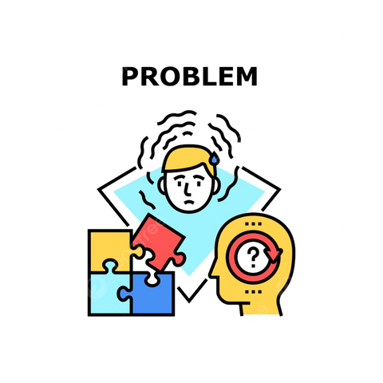




Suggested solution
Smart Web Application
Recommendation system

Slide 9
Introduction
1
1.1 Problem Statement
1.2 Suggested Solution
1.3 Project aim and Objectives

Slide 10



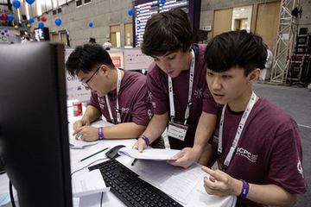

Objectives
ICPC Simulation
Team Collaboration
Recommendation
Mirror ICPC format
Time limits included c
Set challenging problems
Facilitate teamwork sessions.
Support collaborative problem-solving.
Enable solution sharing.
Foster team cooperation.
Analyze user performance
Identify weaknesses.
Suggest targeted problems.

Slide 11

Introduction
1.1 Problem Statement
1.2 Suggested Solution
1.3 Project aim and Objectives

Slide 12
Data Gathering
2
2.1 Similar applications
2.2 Survey Analysis
2.3 System High-Level Design

Slide 13
Data Gathering
2
2.1 Similar applications
2.2 Survey Analysis
2.3 System High-Level Design

Slide 14



Similar apps
Shared Online Editor
Rating Grapgh
create teams with other users
Recommenda-tion system
Editorials and solutions
Mobile App
Virtual contests
Blogs
Web App
Contest
Chat
CodeForces
LeetCode
UVa
SPOJ
CodeChef
CollabCode

Slide 15
Data Gathering
2
2.1 Similar applications
2.2 Survey Analysis
2.3 System High-Level Design

Slide 16
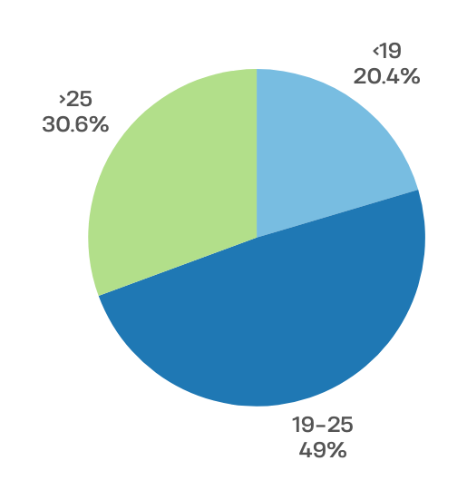
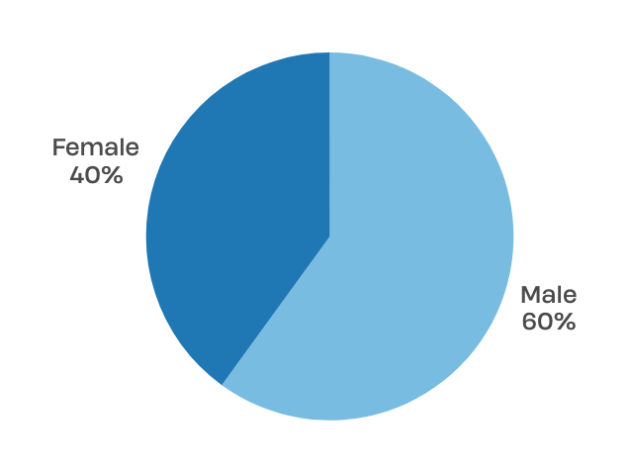
Survey Analysis
1- Age Distribution
2- Gender Distribution

Slide 17
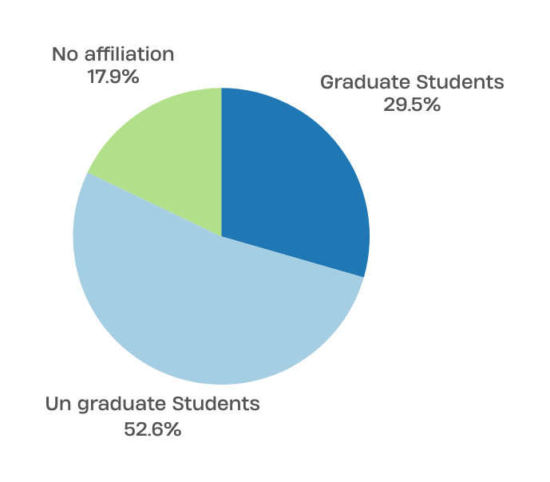
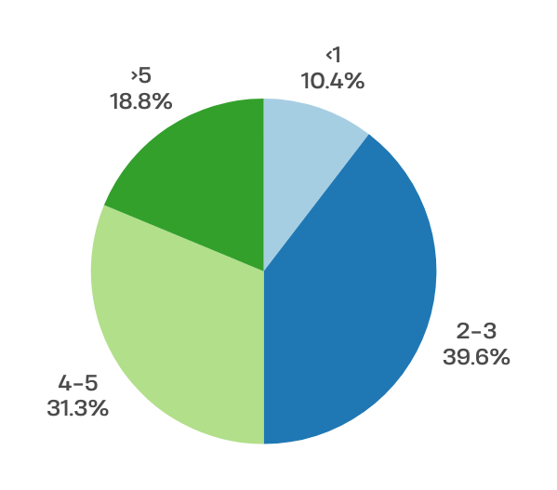
Survey Analysis cont..
Survey Analysis
3- College Affiliation Percentage
4- Programming Experience

Slide 18
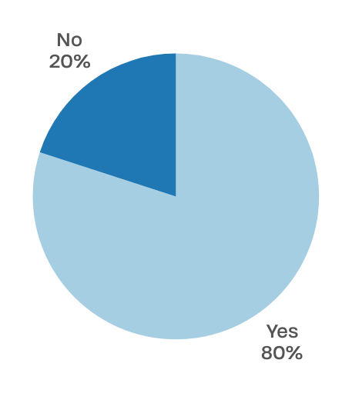
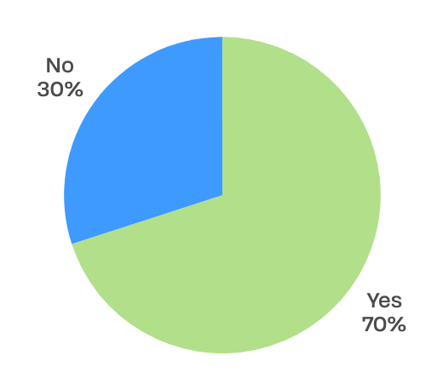
Survey Analysis cont..
5- Familarity with online judges
6- Participation in Team-based Activities

Slide 19
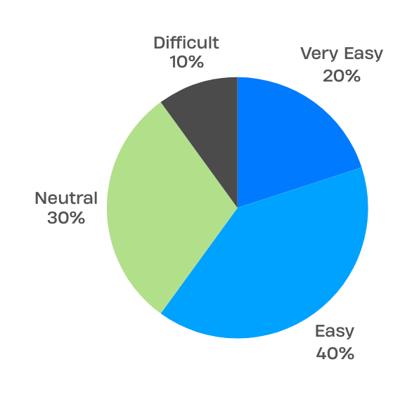
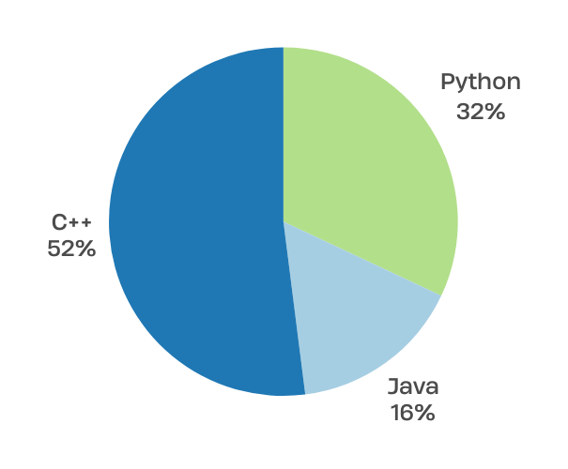
Survey Analysis
Survey Analysis cont..
7- User Interface Accessibility
8- Preferred Programming Language

Slide 20
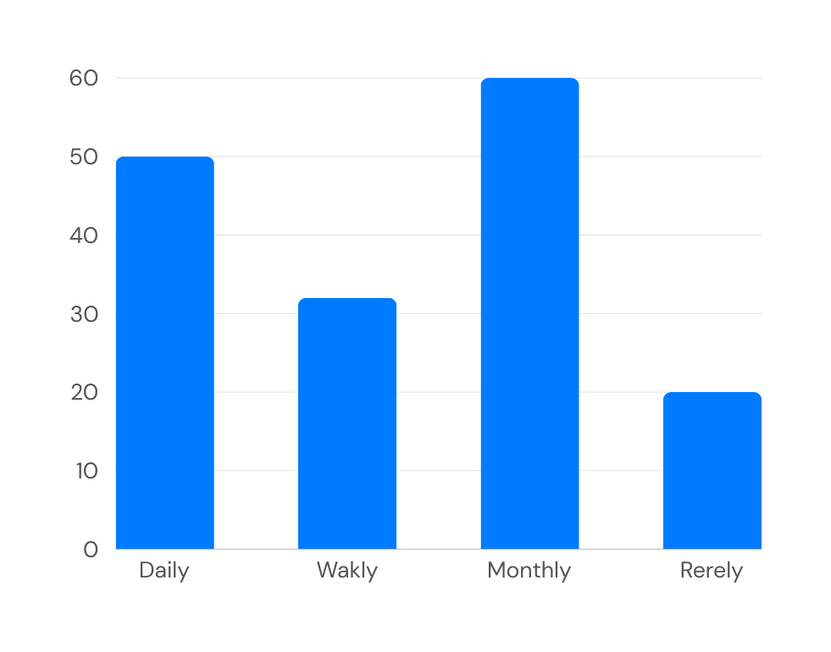
What about Frequency of Engagement with Online Judges ?

Slide 21
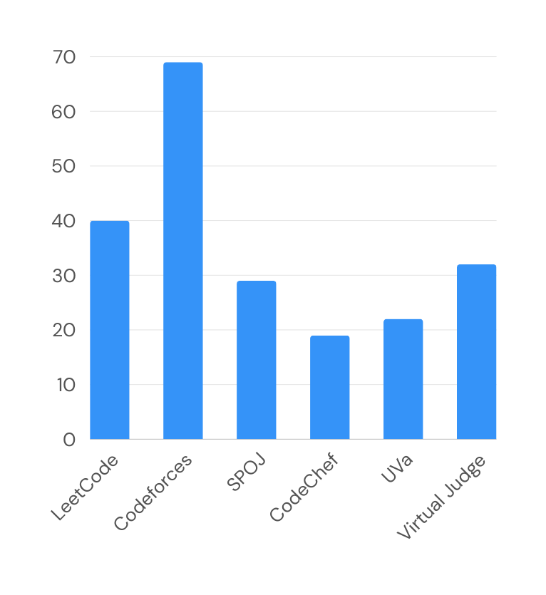
6- What is the best Online Judge for you you ?

Slide 22
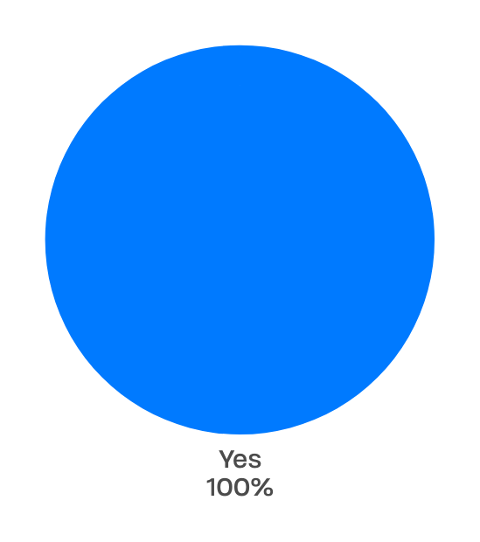
Would a consolidated website offering essential features from multiple online judges and additional tools like a recommendation system be superior to using separate apps such as CodeForces, LeetCode, Codechef, UVA, and SPOJ?

Slide 23
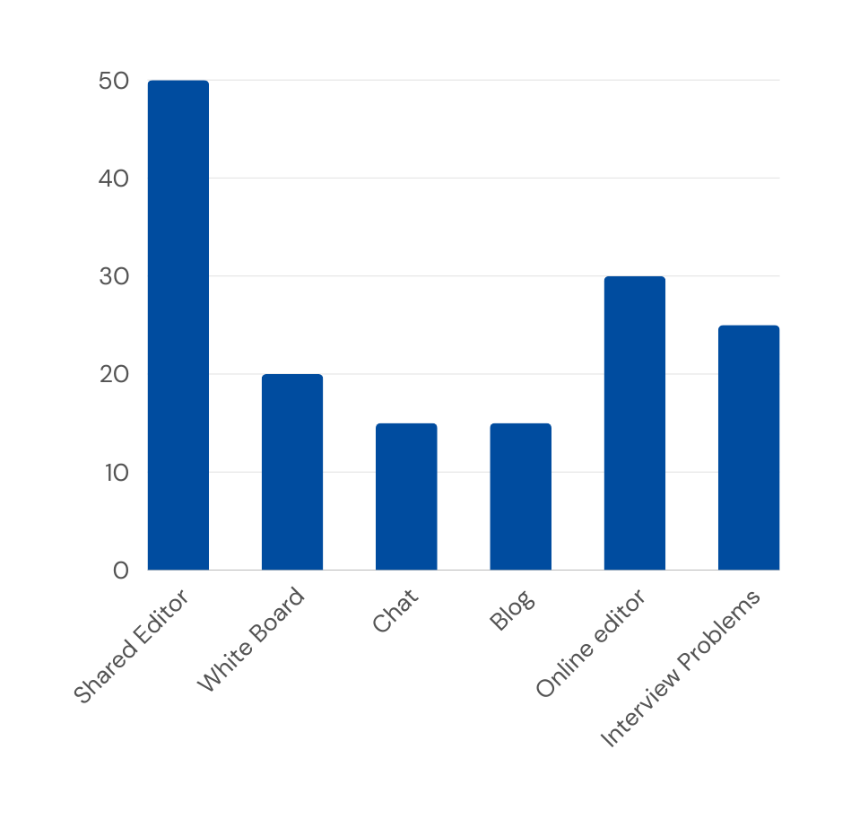
6- What are the features you think it will be helpful in your Online Judges?

Slide 24
Data Gathering
2
2.1 Similar applications
2.2 Survey Analysis
2.3 System High-Level Design

Slide 25
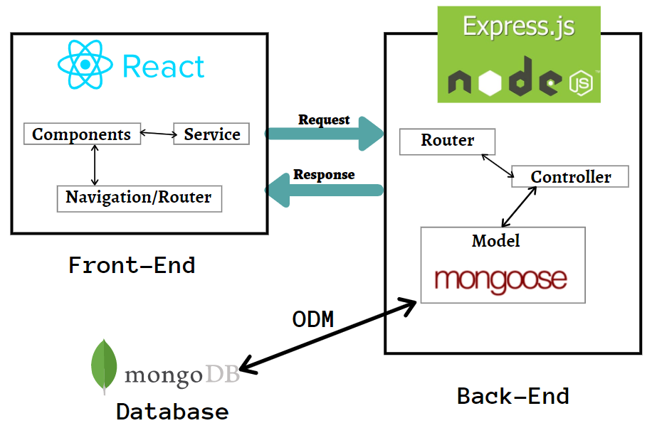












High Level Design System
For the Web application development we used MERN stack with websockets for the real-time communication.
Figma
React js
Node js
Express js
Tailwind CSS
Redux
Flowbite React
Mongo db
Git/Github
Postman
VS Code
Jest js

Slide 26
Data Gathering
2.1 Similar applications
2.2 Survey Analysis
2.3 System High-Level Design

Slide 27
Rating System
3
3.1 Rank calculation
3.2 How does the Rating system work?
3.3 Elo Rating System
3.4 Applying Elo rating to our system

Slide 28
Rating System
3
3.1 Rank calculation
3.2 How does the Rating system work?
3.3 Elo Rating System
3.4 Applying Elo rating to our system

Slide 29
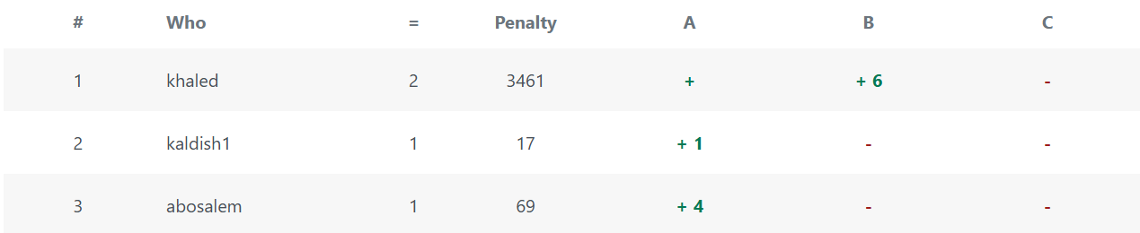
Rank calculation
Each wrong submission has a 10-minute penalty (not counted yet)
Accepted submission has a penalty equal to the sum of the current minute in the contest and previous wrong submissions penalty.
Any submission after the first accepted one is not counted.
The One who solves more problems has a higher rank.
If two users solve the same number of problems, the one with less penalty has a higher rank.

Slide 30
Rating System
3
3.1 Rank calculation
3.2 How does the Rating system work?
3.3 Elo Rating System
3.4 Applying Elo rating to our system

Slide 31
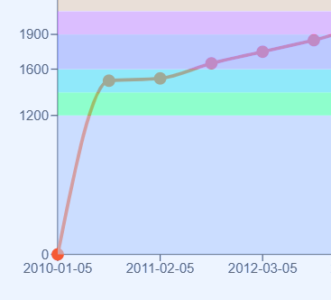
How does the Rating system work?
The new account's initial rating is 1400.
The actual rating is 0 for the first 6 contests (placement period).
A huge + delta is added to a rating in the placement period contests.
After the placement period, your shown rating equals your real one.
The rating is calculated based on the performance in the contest (position in standing)
Your real rating is recalculated based on your position in the contest standings and your expected position in standings based on Elo rating

Slide 32
Rating System
3
3.1 Rank calculation
3.2 How does the Rating system work?
3.3 Elo Rating System
3.4 Applying Elo rating to our system

Slide 33
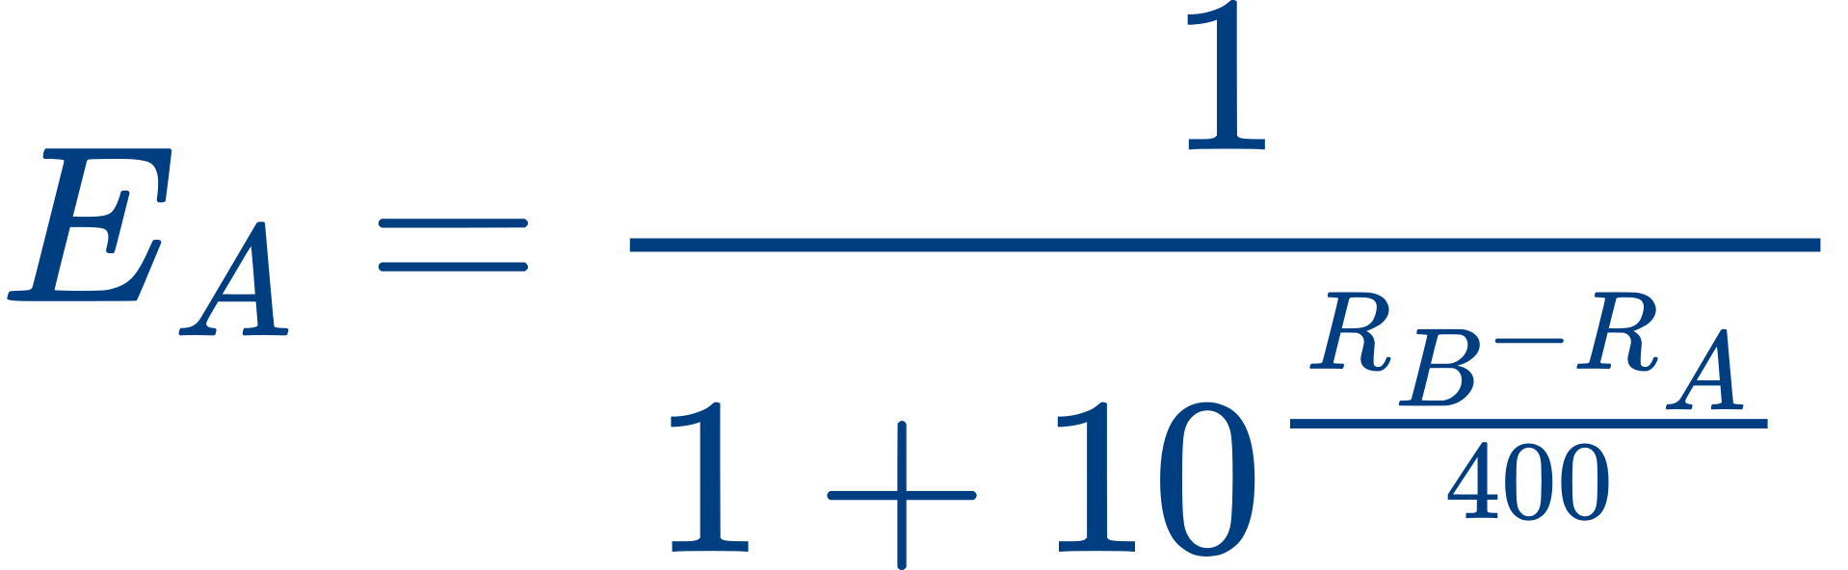
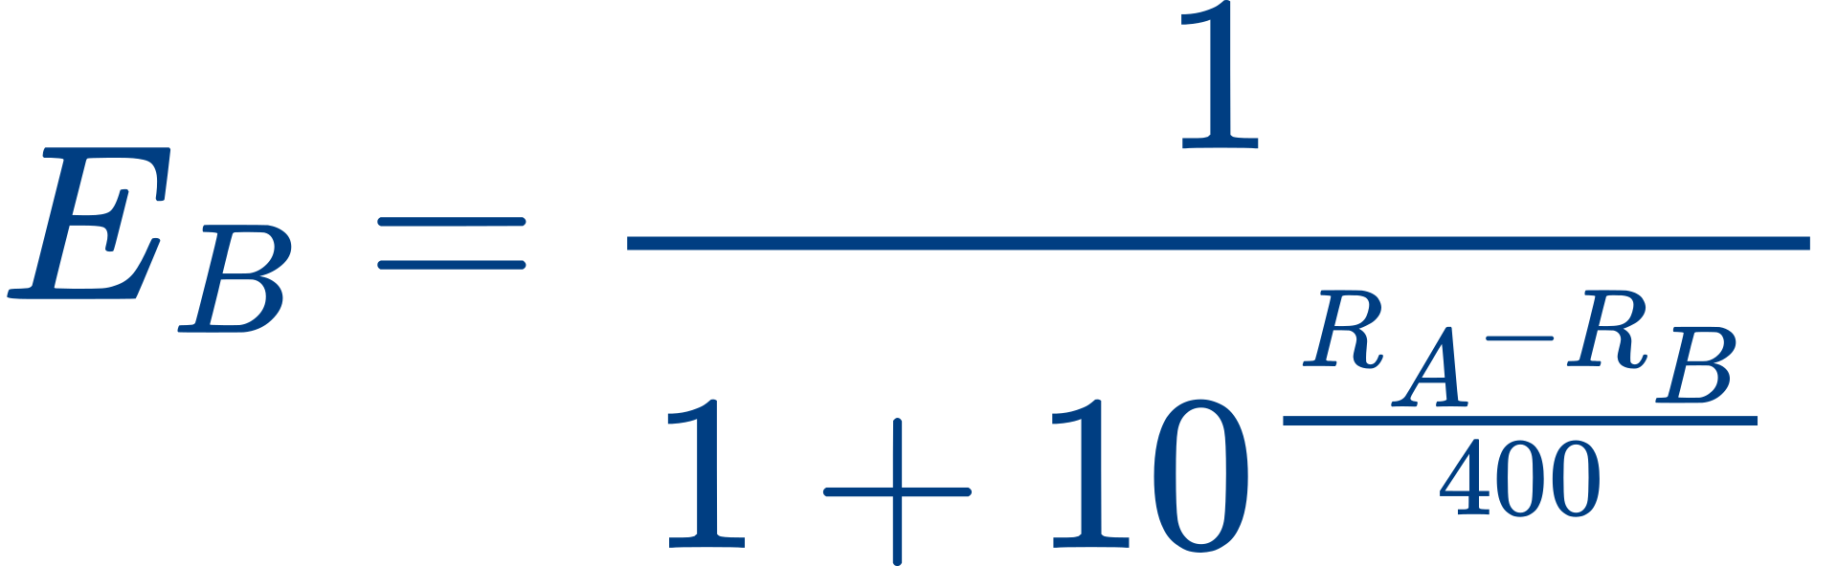
Elo Rating System
A method for calculating the relative skill levels of players in two-player games such as chess
Rating Calculation: Each player has a numerical rating, typically starting at 1400 for a new player. The rating changes based on the outcome of games they play.
Expected Score: The expected score for a player in a match is determined by the difference in ratings between the two players.

Slide 34


Elo Rating System cont...
Actual Score: The actual score is 1 for a win, 0.5 for a draw, and 0 for a loss. For example, if Player A wins, their actual score 𝑆𝐴 is 1, and Player B's actual score 𝑆𝐵 is 0.
Rating Update: After the game, the ratings are updated using the formula:
where K is a factor that determines how much the rating can change after a game. The value of K can vary, but a common value used is 32

Slide 35
Rating System
3
3.1 Rank calculation
3.2 How does the Rating system work?
3.3 Elo Rating System
3.4 Applying Elo rating to our system

Slide 36
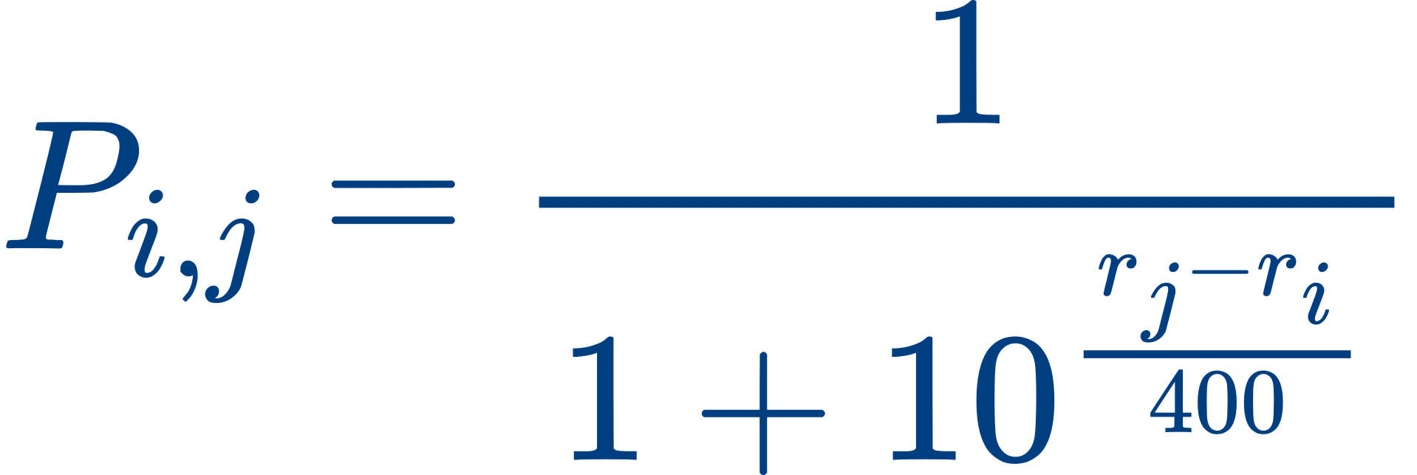
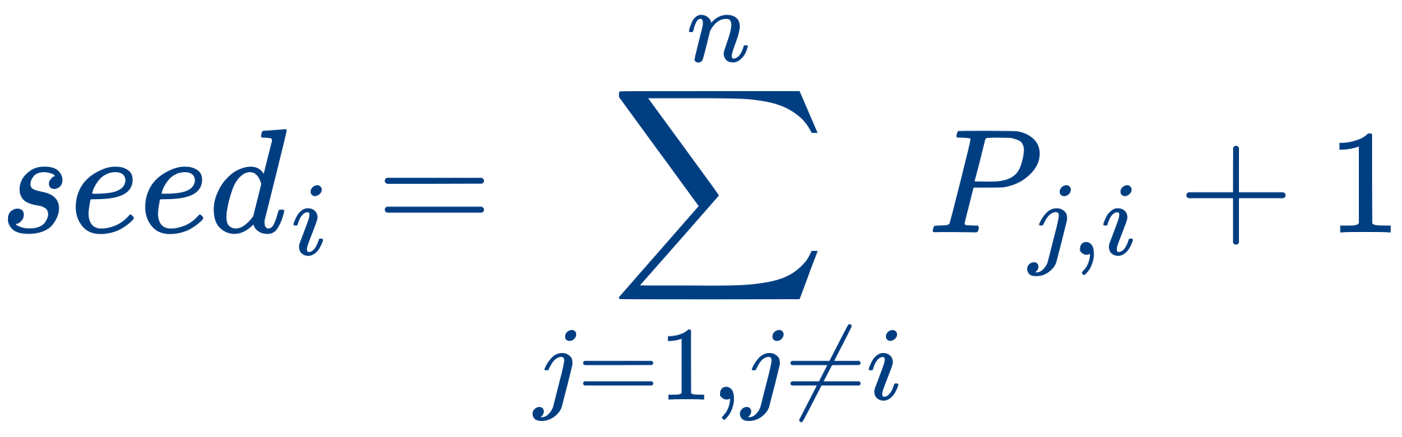
Applying Elo rating to our system
Pi, j is probability that the 𝑖𝑡ℎ participant has better result than the 𝑗𝑡ℎ participant. Therefore for two participants the probability to win/lose depends on subtraction of their ratings
calculate 𝑠𝑒𝑒𝑑𝑖 for each participant before the contest. It equals the sum over all other participants of probabilities to win

Slide 37

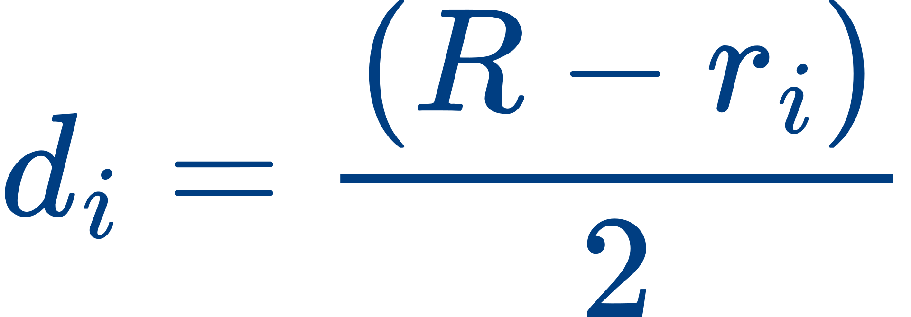
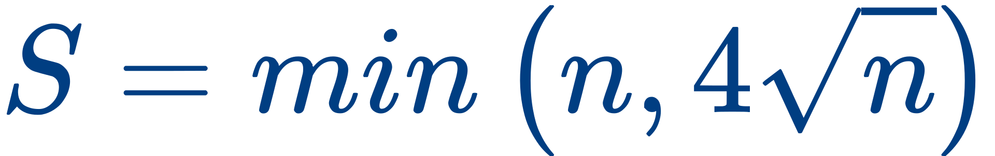
Applying Elo rating to our system cont...
seed
Having and actual place, calculate their geometric mean .
Using binary search find such rating value R which the i-th participant should have to have a .
The rating should be modified to become closer to R. We use
as the rating change for the i-th participant.
i
m
i
r
i
fighting against inflation
Inflation means the rich get richer. We will try to avoid it. Choose a group of participants and decide that their total rating shouldn’t change. We use heuristic value as the size of such a group

Slide 38
Rating System
3
3.1 Rank calculation
3.2 How does the Rating system work?
3.3 Elo Rating System
3.4 Applying Elo rating to our system

Slide 39
Recommendation System
3
4.1 Data
4.2 Approach
4.3 Similarity
4.4 Example

Slide 40
Recommendation System
3
4.1 Data
4.2 Approach
4.3 Similarity
4.4 Example

Slide 41

Data
this section aims to represent the data needed for our recommendation system.
The data needed is from two tables which are as
follows:
Users
problems

Slide 42
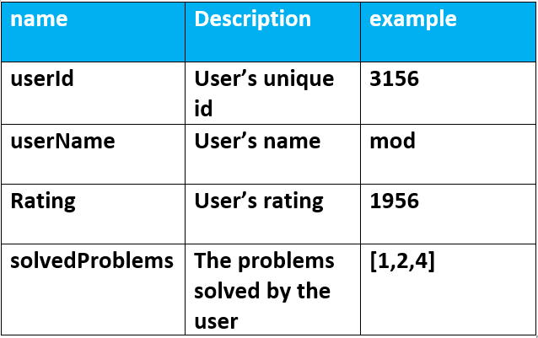
Users Table:

Slide 43
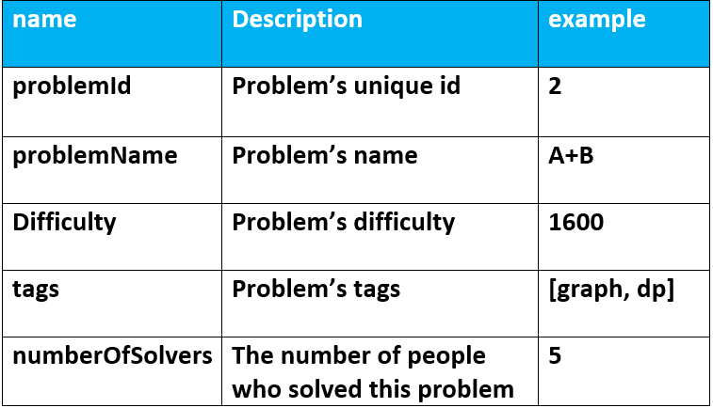
problems Table:

Slide 44
Recommendation System
3
4.1 Data
4.2 Approach
4.3 Similarity
4.4 Example

Slide 45
Approach
Our recommendation system utilizes a collaborative filtering approach to provide recommendations in the following :
problems to user: collaborative approach .

Slide 46
Approach
Our recommendation system recommends problems in order to make the user preforms better, so it recommends problems from similar users.
For each user, the system gives a score to their solved problems corresponding to their similarity with the user that we want to recommend the problems to.

Slide 47
Recommendation System
3
4.1 Data
4.2 Approach
4.3 Similarity
4.4 Example

Slide 48
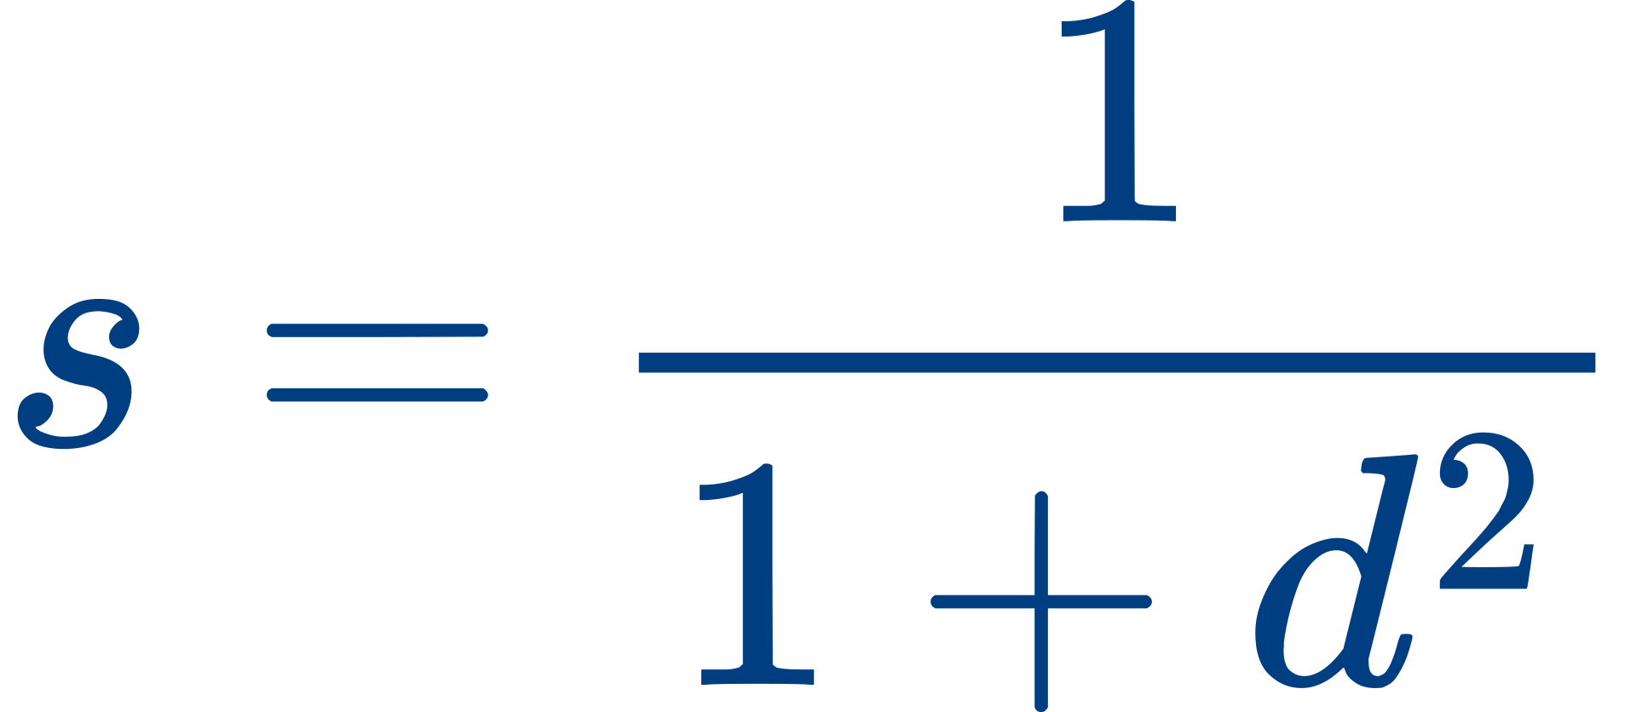
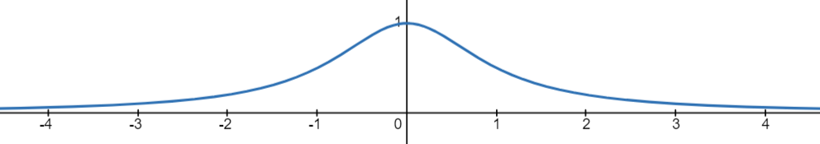
Similarity
The similarity between two users is calculated through the following formula:
where :
S is the similarity
d is the difference of rate between two users

Slide 49
Recommendation System
3
4.1 Data
4.2 Approach
4.3 Similarity
4.4 Example

Slide 50




Example
current users:
user 1
Rating: 1400
user 2
Rating: 1800
user 4
Rating: 2300
user 3
Rating: 1500

Slide 51
Example
current users after calculating similarity:
user 1
Rating: 1400
similarity: 6.2 * 10^-6
similarity: 1.2 * 10^-6
similarity: 9.9 * 10^-3
user 1
Rating: 1800
user 1
Rating: 2300
user 1
Rating: 1500

Slide 52


Example
scores of the problems after users’ weights was added :
user 2
problems solved: 1, 3
similarity: 6.2 * 10^-6
user 3
problems solved: 2
similarity: 9.9 * 10^-3
user 4
problems solved: 3, 4
similarity: 1.2 * 10^-6
Problem 1
score: 6.2 * 10^-6
Problem 2
score: 9.9* 10^-3
Problem 3
score: 7.4 * 10^-6
Problem 4
score: 1.2 * 10^-6

Slide 53
Recommendation System
4.1 Data
4.2 Approach
4.3 Similarity
4.4 Example

Slide 54
Web Application
4
5.1 Functional Requirements
5.2 Non-functional Requirements
5.3 Database
5.4 Web Application Design

Slide 55
Web Application
4
5.1 Functional Requirements
5.2 Non-functional Requirements
5.3 Database
5.4 Web Application Design

Slide 56

Communication
User registration and login.
Chat
Instant Messaging
File Sharing
Blogs
Comment and Disscussions
Media Support
Streams
Live Video Streaming
Screen Sharing

Slide 57

Contest Management
Contest Creation
Scheduling and Notifications
Live Contests
Virtual Contest
Submission and Evaluation
Real-Time Feedback
Resubmission Policies
Leaderboard and Rankings
Dynamic Leaderboards
Global Rankings

Slide 58

User Managment
User Profile
statistics
Friends
Groups
Submissions
User Progress Tracking
Progress Graphs
Calendar Grid

Slide 59

Recommendation system
Analyze user behavior and preferences.
Personalize recommendations for each user based on their rate and problems solved.

Slide 60
Web Application
4
5.1 Functional Requirements
5.2 Non-functional Requirements
5.3 Database
5.4 Web Application Design
5.5 Web Application Demo

Slide 61
Non-functional Requirements
The website should be:
Reliable.
User-friendly.
Include fast page load times and minimal latency.
Highly available with minimal downtime.
Accessible

Slide 62
Web Application
4
5.1 Functional Requirements
5.2 Non-functional Requirements
5.3 Database
5.4 Web Application Design

Slide 63
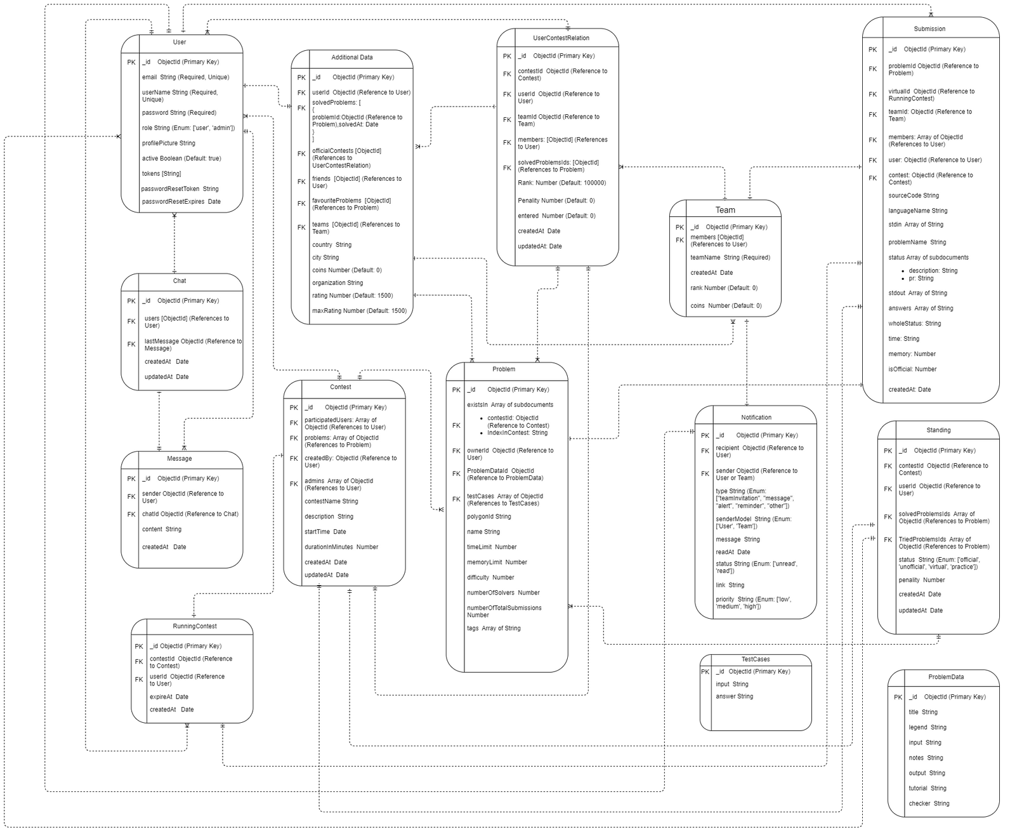


Database
schema

Slide 64
Web Application
4
5.1 Functional Requirements
5.2 Non-functional Requirements
5.3 Database
5.4 Web Application Design

Slide 65

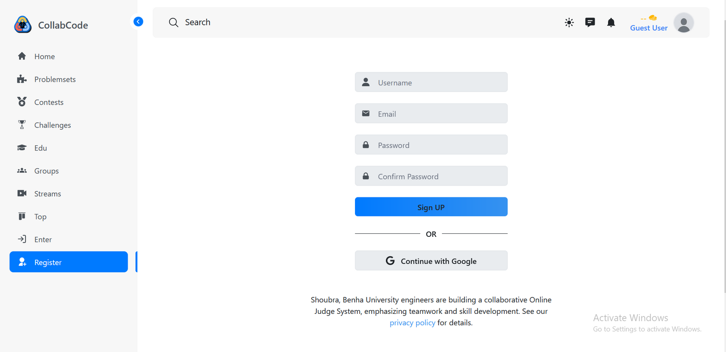
SignUp

Slide 66
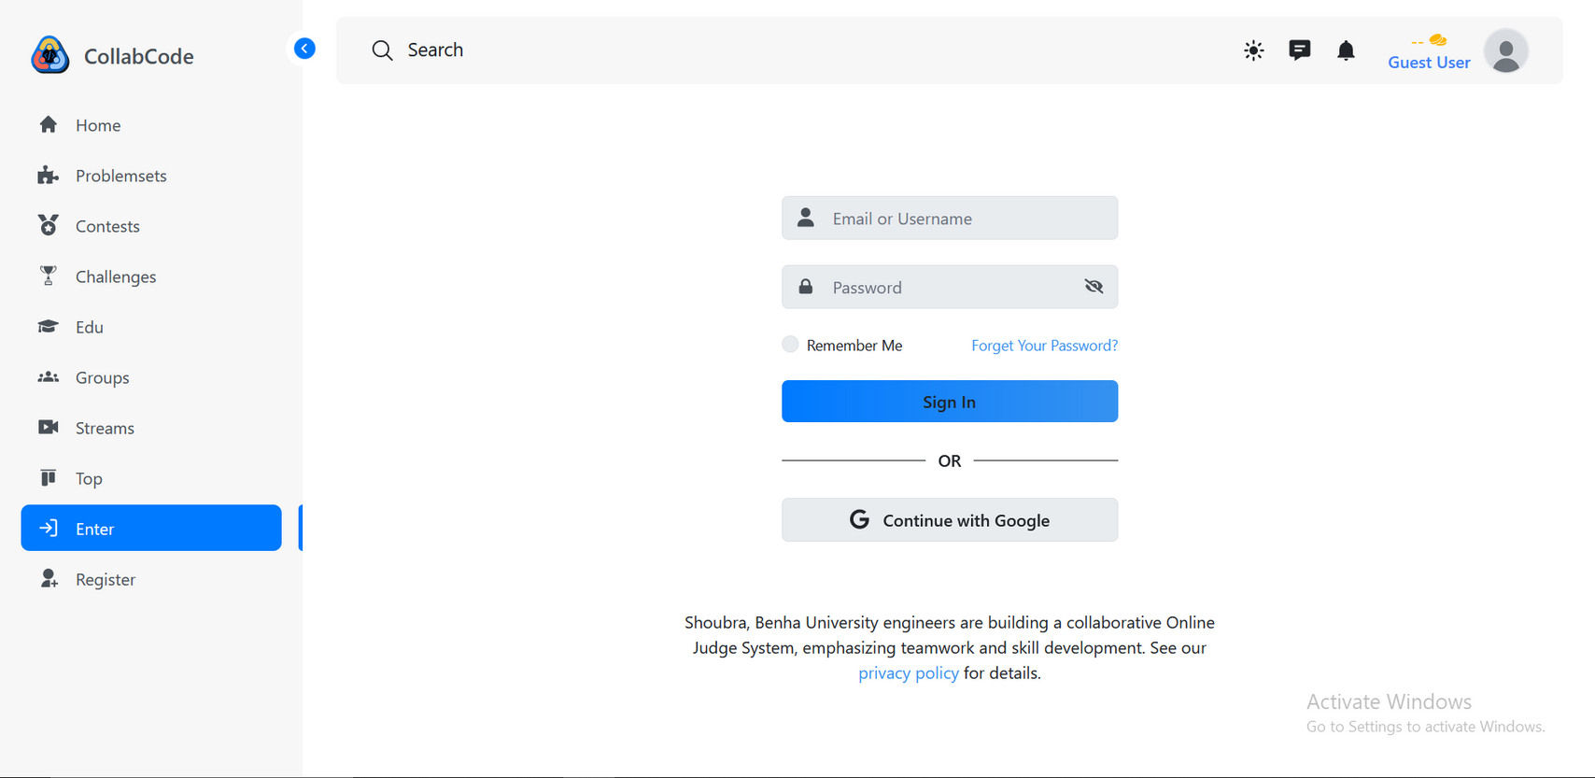
LogIn

Slide 67
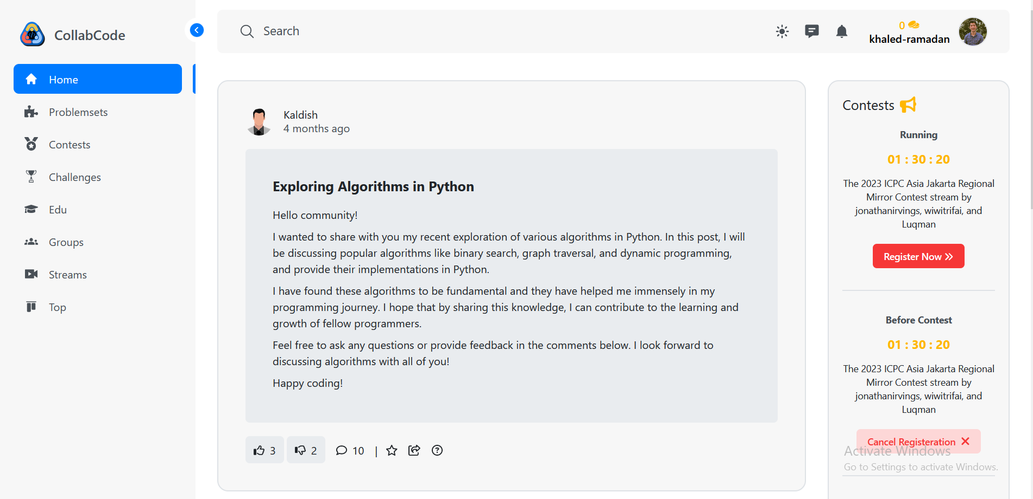
Home

Slide 68
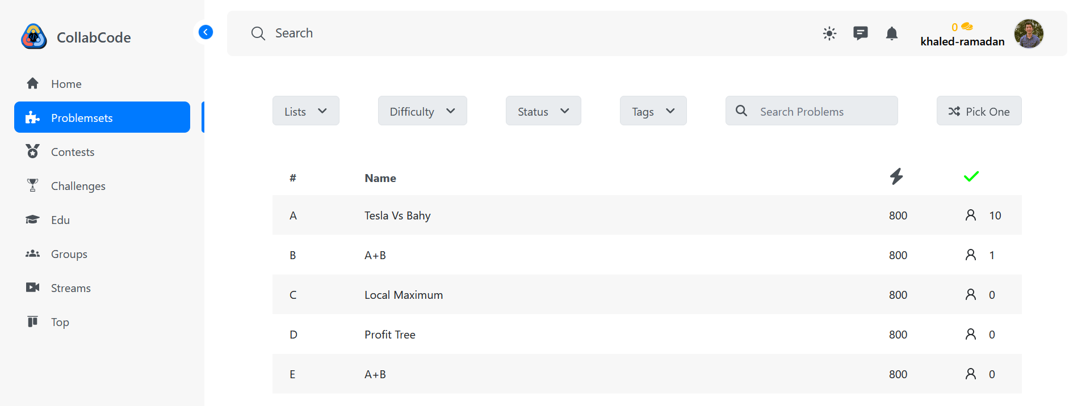
Problemset

Slide 69
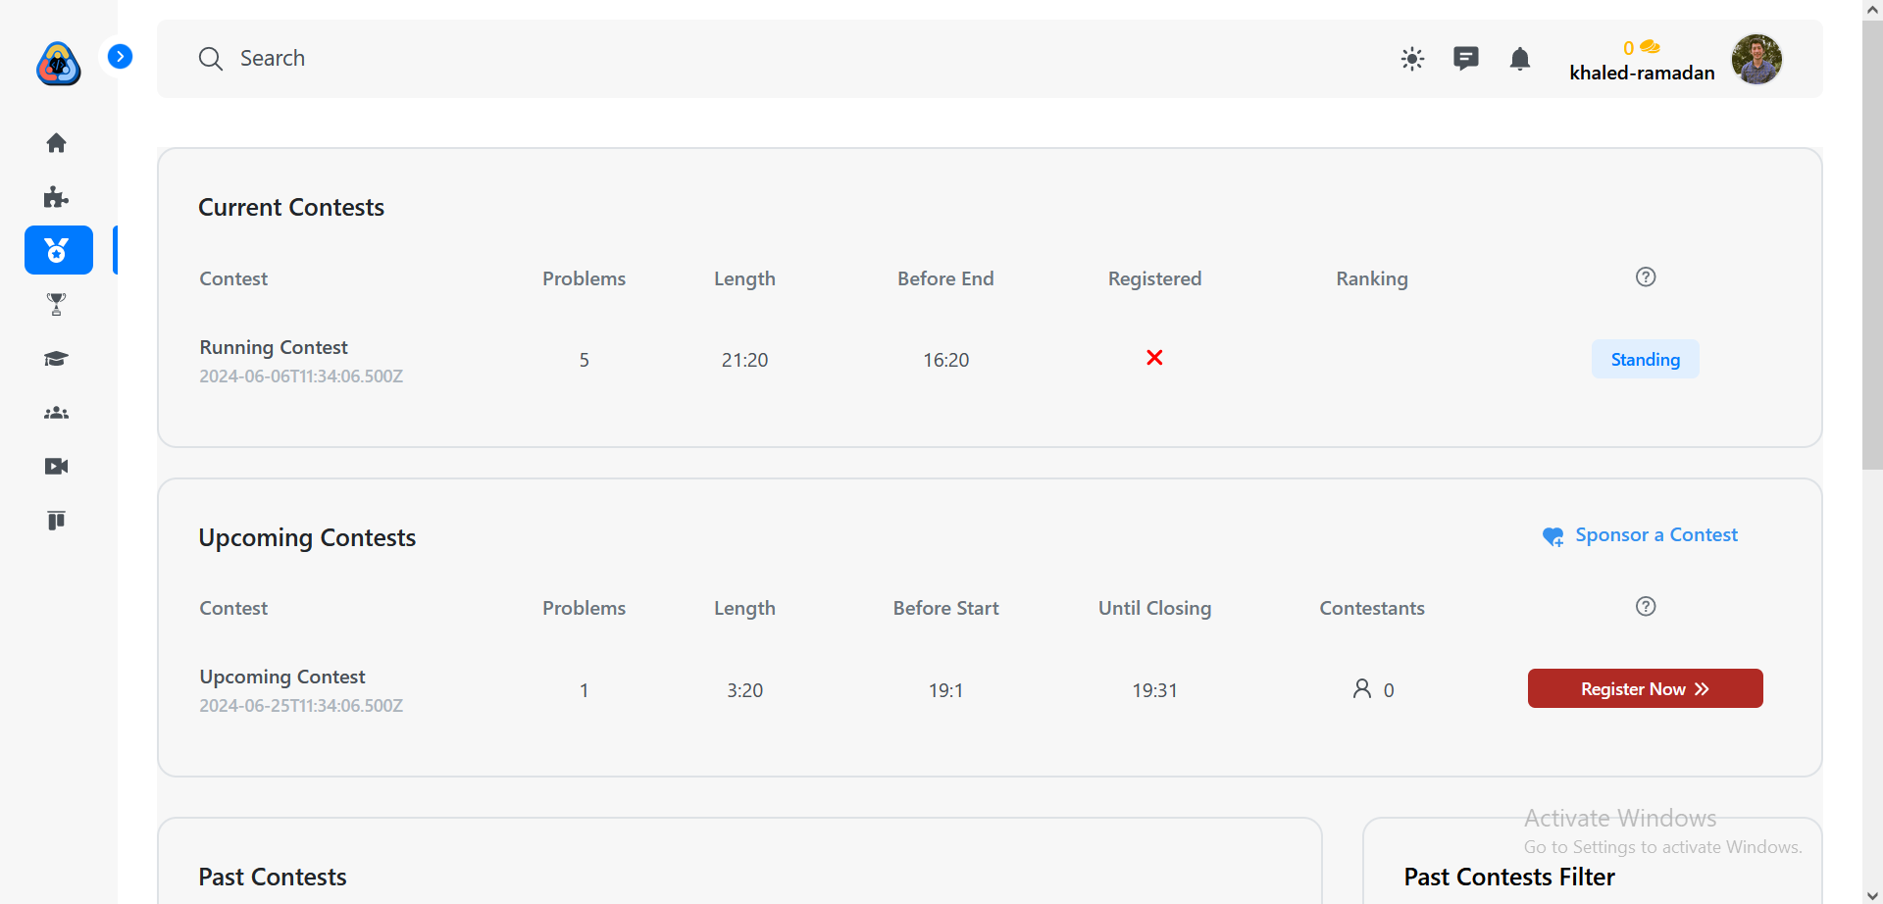
Contests

Slide 70
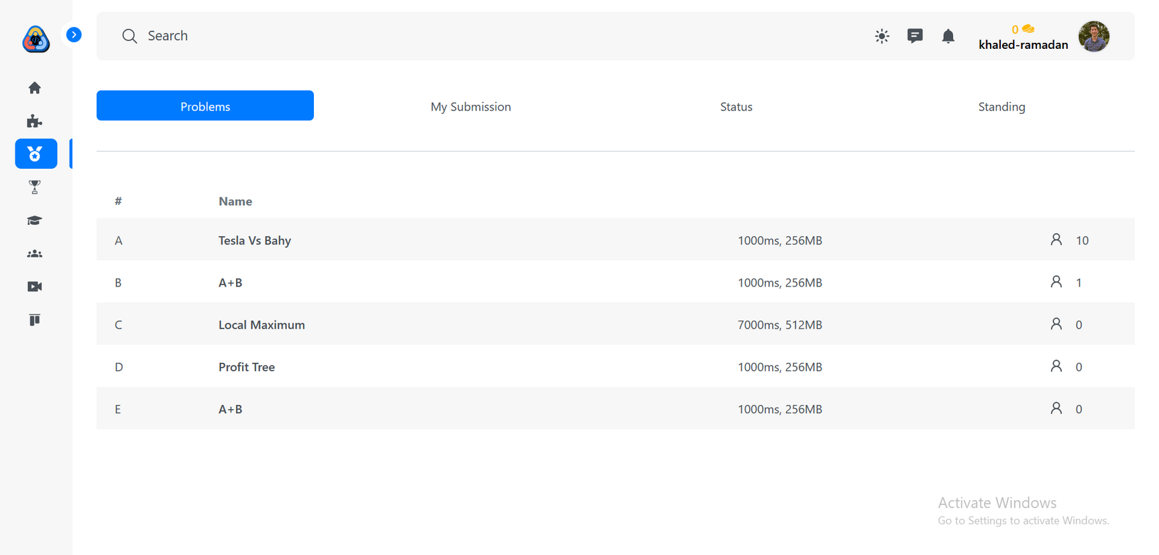
Contest’s problems

Slide 71
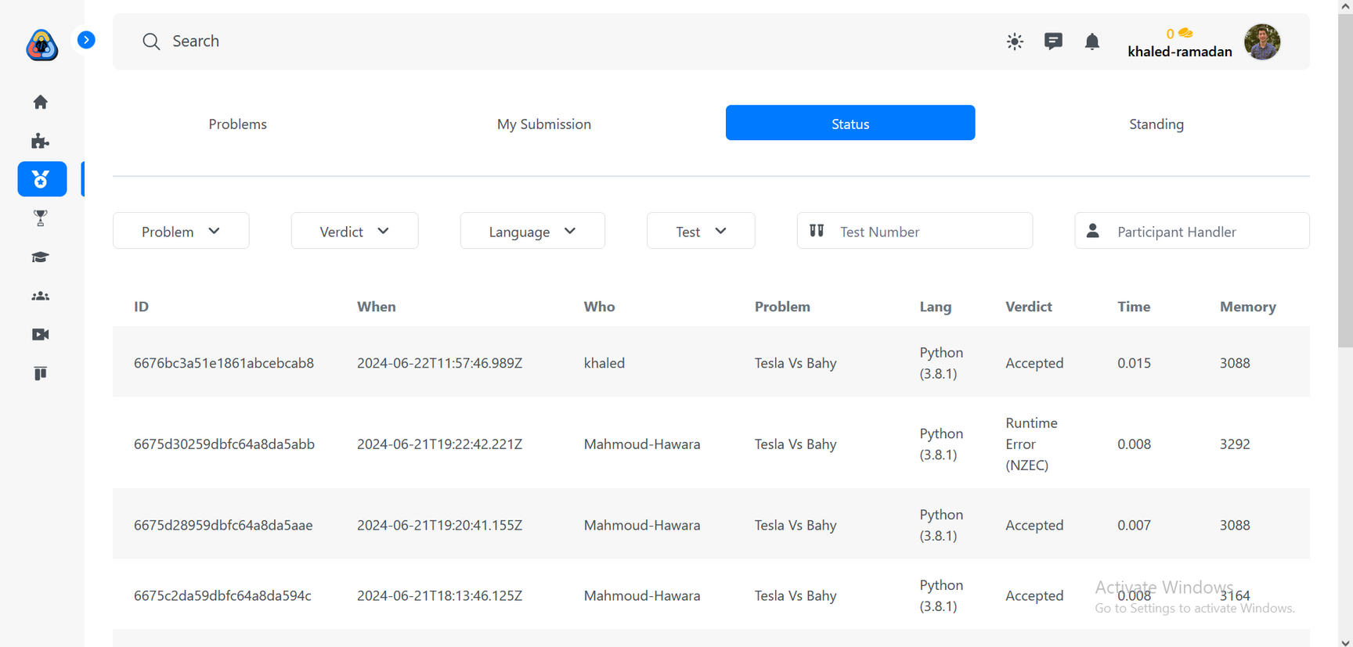
Contest’s status

Slide 72
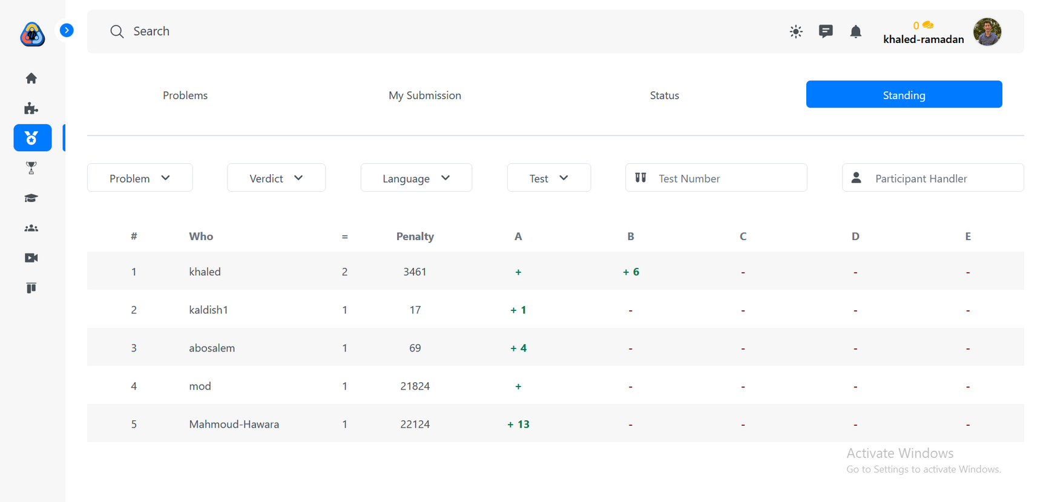
Contest’s Standing

Slide 73
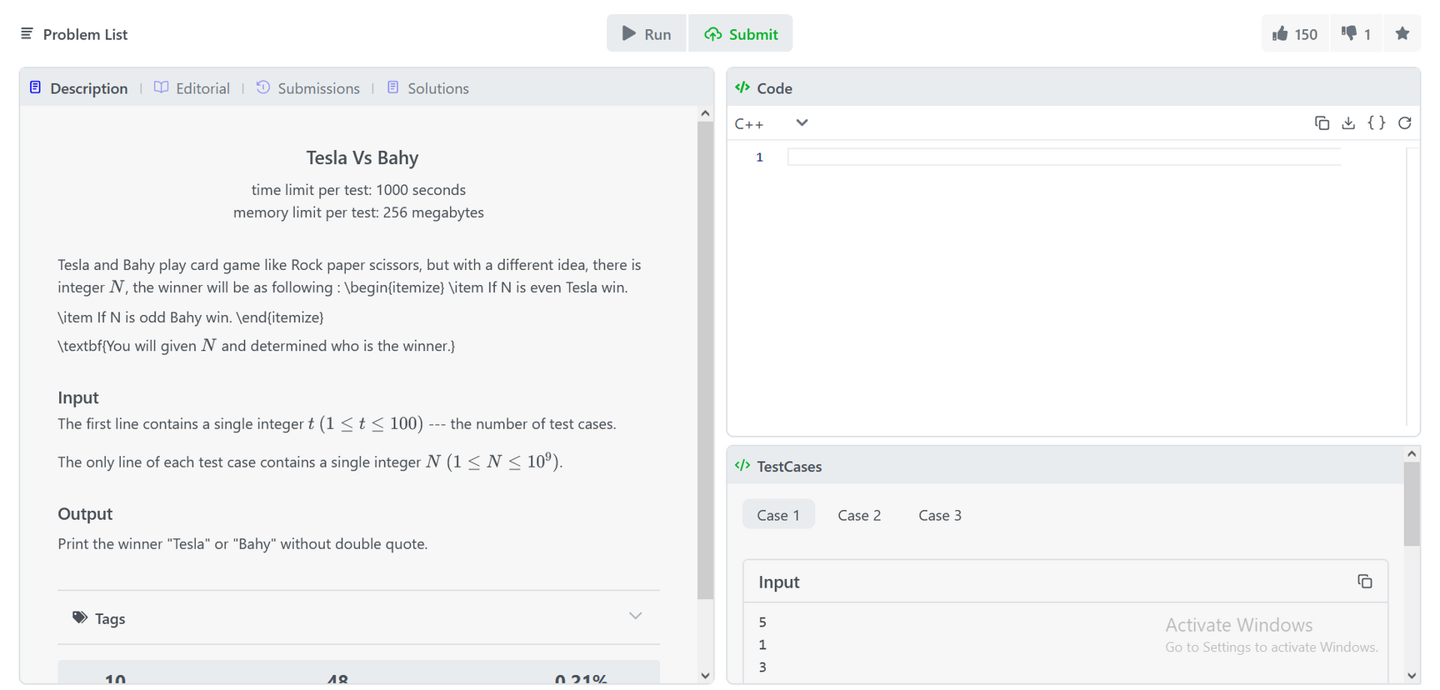
Problem

Slide 74
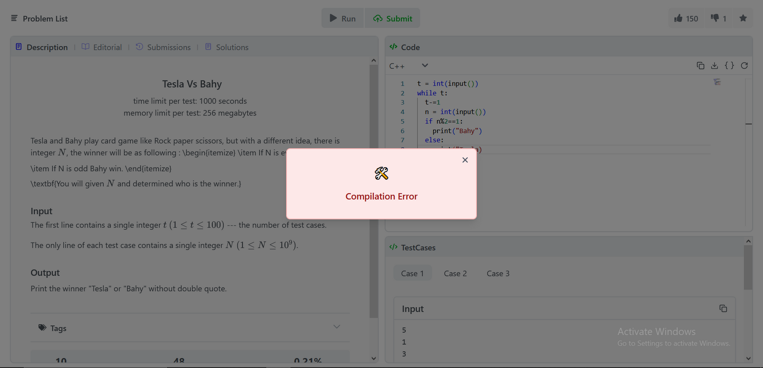
Submit: Accept

Slide 75
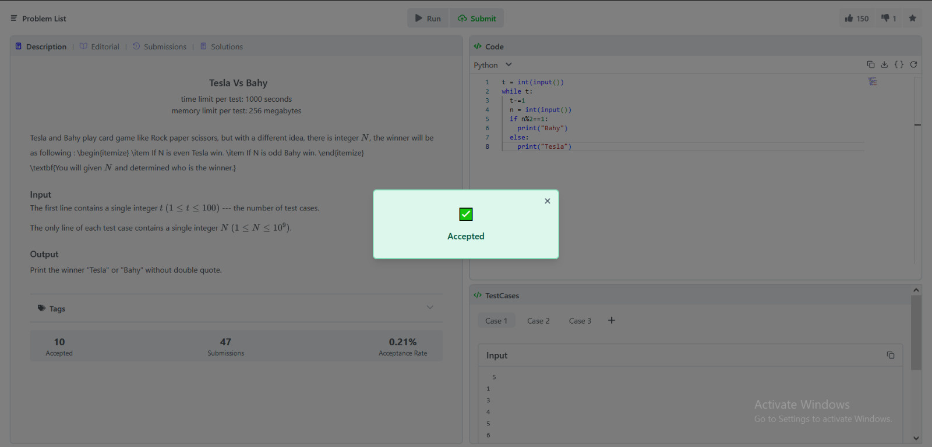
Submit: Compilation Error

Slide 76
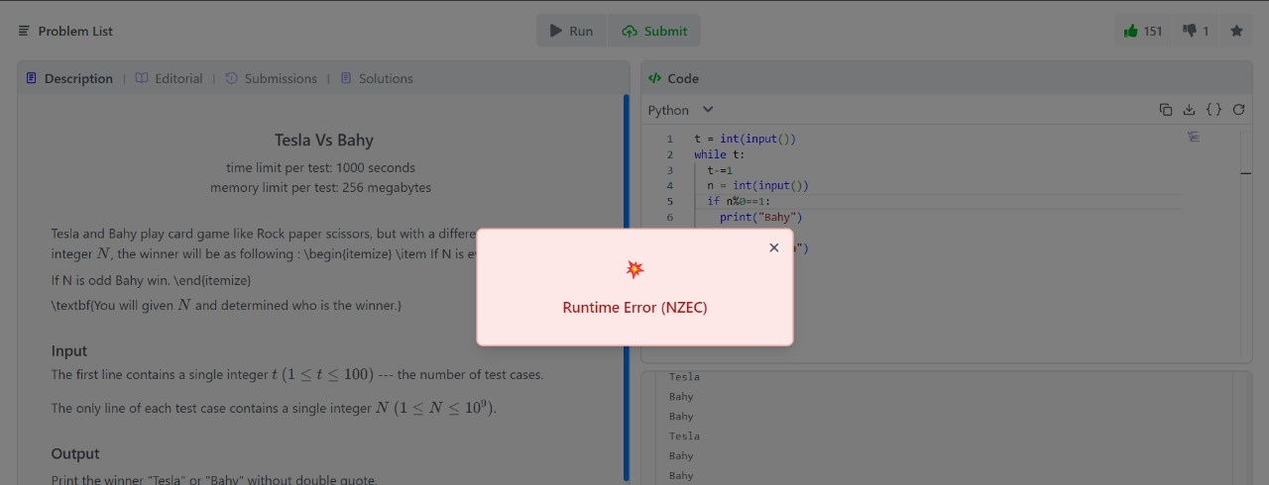
Submit: Run Time Error

Slide 77
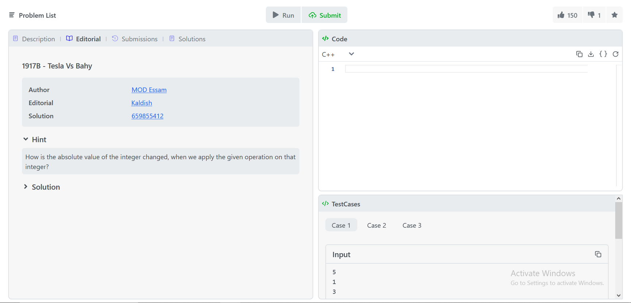
Problem’s Editorial

Slide 78
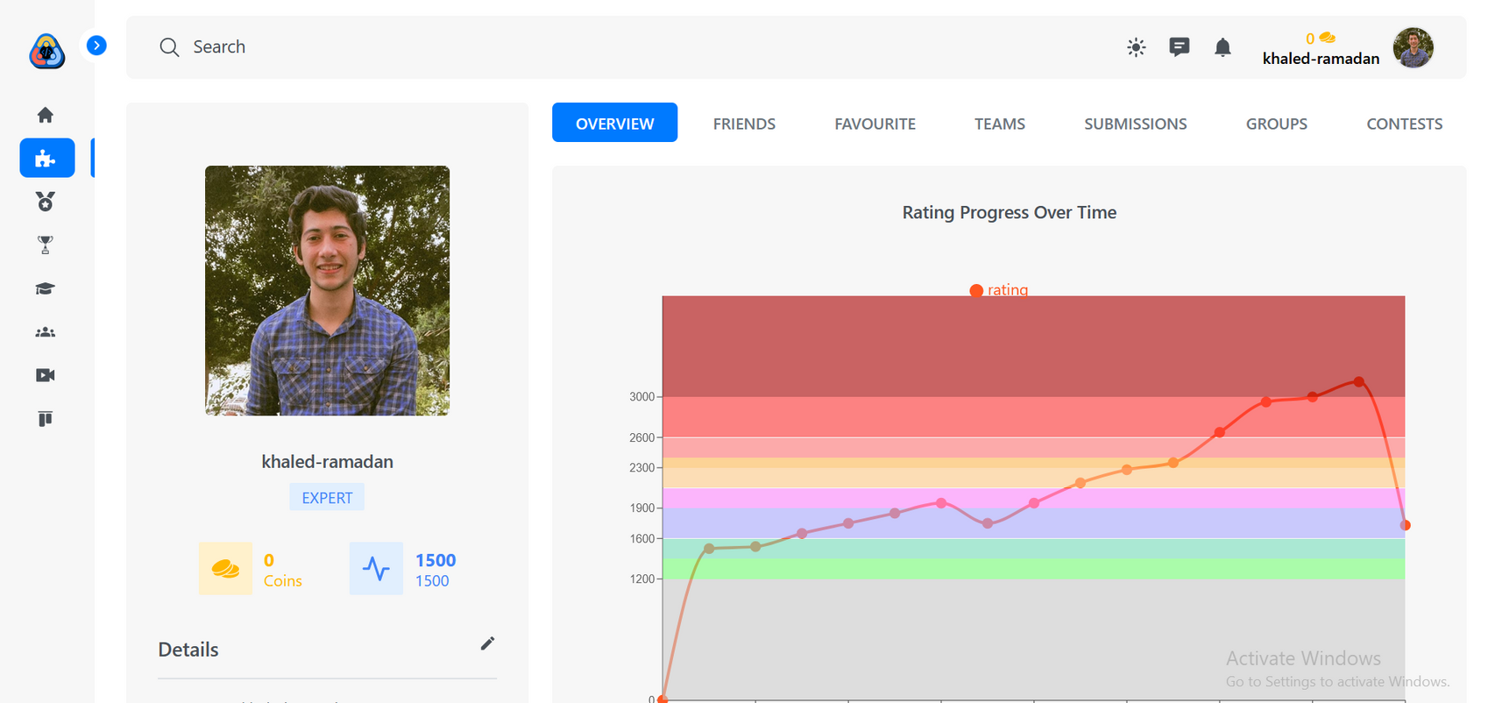
Profile

Slide 79
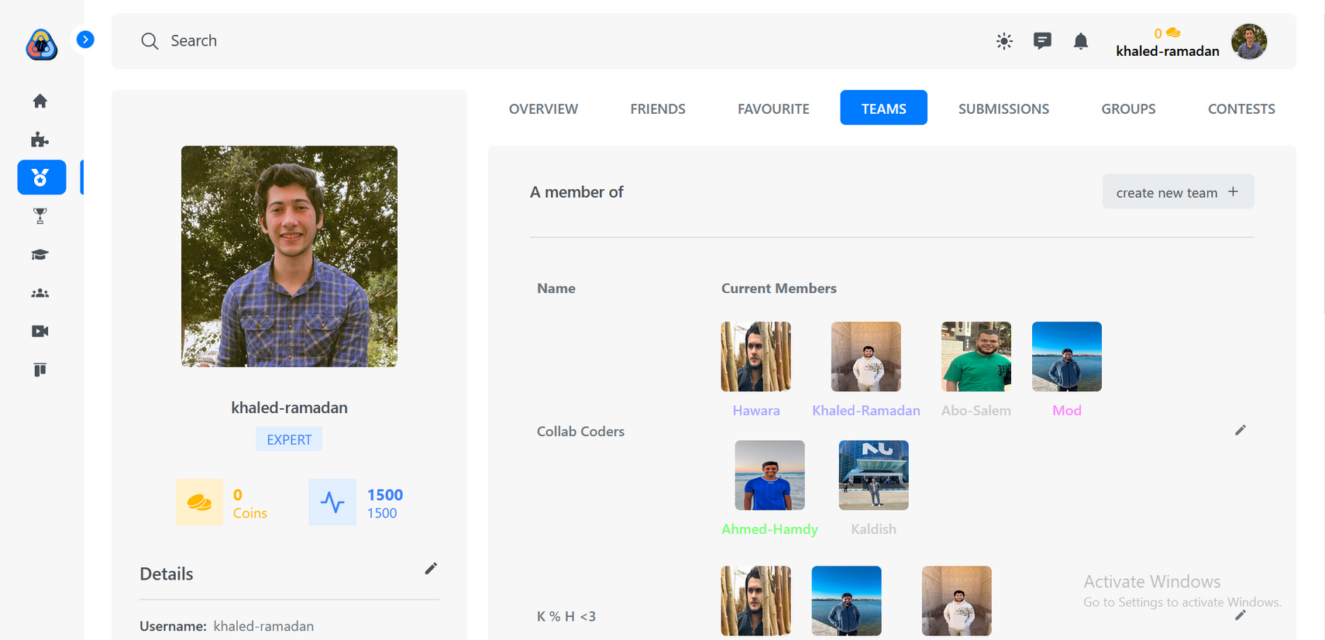
Teams

Slide 80
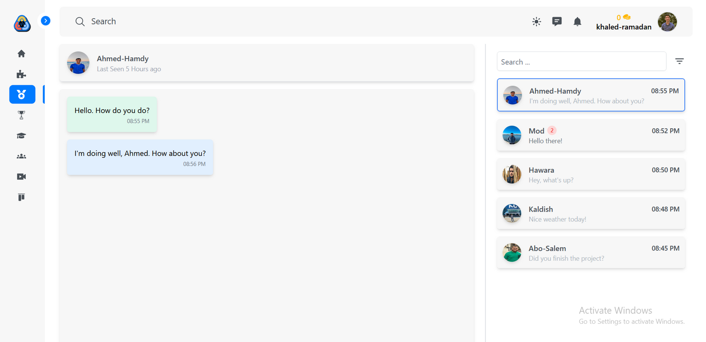
Chat

Slide 81

Recommendation system

Slide 82
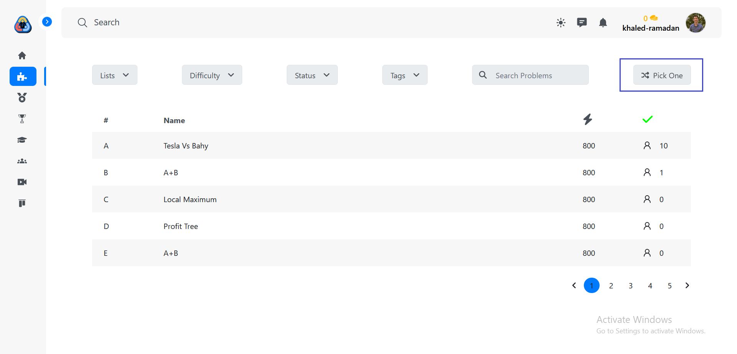
Recommendation system

Slide 83
Recommendation system

Slide 84
Web Application
5.1 Functional Requirements
5.2 Non-functional Requirements
5.3 Database
5.4 Web Application Design

Slide 85
System Testing
5
6.1 Backend Test

Slide 86
System Testing
5
6.1 Backend Test

Slide 87
Backend Test
Backend testing is crucial for ensuring the robustness and functionality of the server-side components and APIs in an application.
For testing purposes, we used:
testing frameworks like Jest a widely-used JavaScript testing framework, to define and execute test cases.
libraries like SuperTest and MongoDB in-memory server.

Slide 88
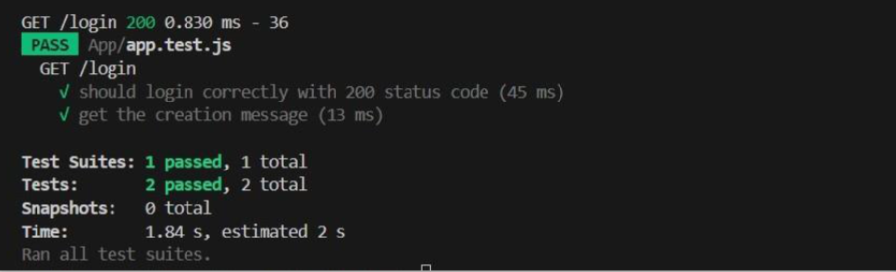
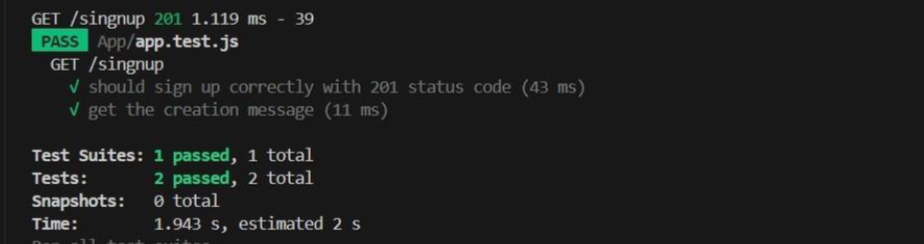
Backend Test

Slide 89
System Testing
5
5.1 Backend Test

Slide 90
Conclusion
6
7.1 Challenges
7.2 Future Work

Slide 91
Challenges
Challenge #1
Simulating ICPC Environment
Response
Implemented time constraints, problem sets, and submission protocols to replicate the ICPC competition format.

Slide 92
Challenges cont..
Challenge #2
Facilitating Team Collaboration Online
Response
Developed a shared editor with controlled access, real-time chat, and online meeting capabilities.

Slide 93
Challenges cont..
Challenge #3
Analyzing User Performance.
Response
Created a recommendation system that evaluates performance and suggests targeted problems for improvement.

Slide 94
Challenges cont..
Challenge #3
Maintaining User Engagement
Response
Introduced rewards and recognition such as badges, certificates, and virtual trophies to incentivize active participation.

Slide 95
Conclusion
6
7.1 Challenges
7.2 Future Work

Slide 96
Future Work
In terms of future work, there are several important additions and improvements planned for our website
(1) Enhanced AI-Driven Recommendations:
Upgrade the recommendation system with advanced AI to tailor problem suggestions based on user coding styles and mistakes.
(2) Mobile Application:
Develop a mobile-friendly version of the platform for on-the-go practice and collaboration.
(3) Collaboration with Educational Institutions:
Partner with universities and bootcamps to incorporate the platform into their curriculum with tailored training modules.

Slide 97
Future Work cont..
(4) Integration with External Tools:
Integrate with tools like GitHub, offering APIs and plugins for streamlined workflow.
(5) White Dashboard:
Development: Create a clean, intuitive white dashboard interface.
Implementation: Focus on minimalist design, enhancing usability and accessibility.
(6) Multilingual Support:
Provide multilingual support for the interface, documentation, and problems to reach a wider audience.

Slide 98
Conclusion
7.1 Challenges
7.2 Future Work

Slide 99
References
[1] Wasik, S., Antczak, M., Badura, J., Laskowski, A., & Sternal, T. (2018). A survey on online judge systems and their applications. ACM Computing Surveys (CSUR), 51(1), 1-34.‏
[2] Y. and D. , "Software development methodologies," White paper, pp. 40-48, 2013.
[3] A. and P. , "Agile software development methods: Review and analysis," Review and analysis, pp. 60-69, 2017.
[4] D. S. K. and P. D. , "Software development life cycle (SDLC) analytical comparison and survey on traditional and agile methodology," Natl.
Mon. Ref. J. Res. Sci, pp. 22-30, 2013.
[5] S. M. t. and J. M. , "A study of BIM collaboration requirements and available features in existing model collaboration systems," Journal of Information Technology in Construction, vol. 25, no. 8, pp. 148-161,
2018.

Slide 100
References cont..
[6] A. and M. , "Full-duplex communication in cognitive radio networks," IEEE Communications Surveys & Tutorials, vol. 35, no. 10, pp. 2158- 2191, 2017.
[7] P. V. and B. G. N. , "Communicating and displaying real-time data with websocket," IEEE Internet Computing, vol. 8, no. 11, pp. 45-53, 2012.
[8] P. I. and P. A. , "The use of machine learning algorithms in recommender systems," Expert Systems with Applications, vol. 97, no. 13, pp. 205-227, 2018.
Page 211Page 212
[9] P. M. J. and . D. B. , "Content-based recommendation systems," The adaptive web: methods and strategies of web personalization, vol. 45, no. 13, pp. 325-341, 2007.
[10] Q. and J. R. , "Learning decision tree classifiers," ACM Computing
Surveys (CSUR), vol. 20, no. 14, pp. 71-72, 1996.

Slide 101
References
References cont..
[11] Brooke, John. “SUS: A ‘Quick and Dirty’ Usability Scale.” Usability Evaluation In Industry, CRC Press, 1996, pp. 207–12, http://dx.doi.org/10.1201/9781498710411-35.
[12] “Measuring Usability with the System Usability Scale (SUS) – MeasuringU.” MeasuringU – UX Research and Software, https://measuringu.com/sus/.
[13] Brooke, John. SUS: A Retrospective. Jan. 2013.
[14] Bangor, Aaron, et al. Determining What Individual SUS Scores Mean: Adding an Adjective Rating Scale. 2009.
[15] PhD, Jeff Sauro. “5 Ways to Interpret a SUS Score – MeasuringU.”
MeasuringU – UX Research and Software, https://measuringu.com/interpret-sus-score/.

Slide 102
References
References cont..
[16] Smyk, Andrew. “The System Usability Scale & How It’s Used in UX | by Andrew Smyk | Thinking Design | Medium.” Medium, Thinking Design, 28 Mar. 2020, https://medium.com/thinking-design/the-system-usability- scale-how-its-used-in-ux-b823045270b7.
[17] Ahmed, Shibbir, and Mahamudul Hasan. User Interaction Analysis to Recommend Suitable Jobs in Career-Oriented Social Networking Sites. 2016.
[18] B.Thorat, Poonam, et al. “Survey on Collaborative Filtering, Content- Based Filtering and Hybrid Recommendation System.” International Journal of Computer Applications, no. 4, Foundation of Computer Science, Jan. 2015, pp. 31–36. Crossref, doi:10.5120/19308-0760.
[19] mfaaris. “Hybrid and Tensorflow Recommender System | Kaggle.” Kaggle: Your Machine Learning and Data Science Community, Kaggle, 27 Oct. 2022, https://www.kaggle.com/code/mfaaris/hybrid-and- tensorflow-recommender-system.

Slide 103
References cont..
References
[20] Singh, Ramni Harbir, et al. “Movie Recommendation System Using Cosine Similarity and KNN.” International Journal of Engineering and Advanced Technology, no. 5, Blue Eyes Intelligence Engineering and Sciences Engineering and Sciences Publication - BEIESP, June 2020, pp. 556–59. Crossref, doi:10.35940/ijeat.e9666.069520.
[21] Isinkaye, F. O., et al. “Recommendation Systems: Principles, Methods and Evaluation.” Egyptian Informatics Journal, no. 3, Elsevier BV, Nov. 2015, pp. 261–73. Crossref, doi:10.1016/j.eij.2015.06.005.
[22] Parthasarathy, Govindarajan, and Shanmugam Sathiya Devi. “Hybrid Recommendation System Based on Collaborative and Content-Based Filtering.” Cybernetics and Systems, no. 4, Informa UK Limited, May 2022, pp. 432–53. Crossref, doi:10.1080/01969722.2022.2062544.
[23] Rifqi Hawari, Ade, et al. “Job Recommendation System Using the Content-Based Filtering Method.” Proceedings of International Conference on [32] Multidiciplinary Research, no. 2, Universitas Serambi Mekkah, Dec. 2022, pp. 138–40. Crossref, doi:10.32672/pic-mr.v5i2.5419.

Slide 104
References
References cont..
[24] “Introduction to Real Time Communication API | Video SDK.” Video SDK Documentation | Video SDK, https://docs.videosdk.live/api-reference/realtime- communication/intro.
[25] “Methods Returned by UseMeeting Hook | Video SDK.” Video SDK Documentation | Video SDK, https://docs.videosdk.live/react/api/sdk-reference/use- meeting/methods.

Slide 105
THANK YOU !

